Slide 1


NYDA ECONOMIC RESEARCH AGENDA

Slide 2


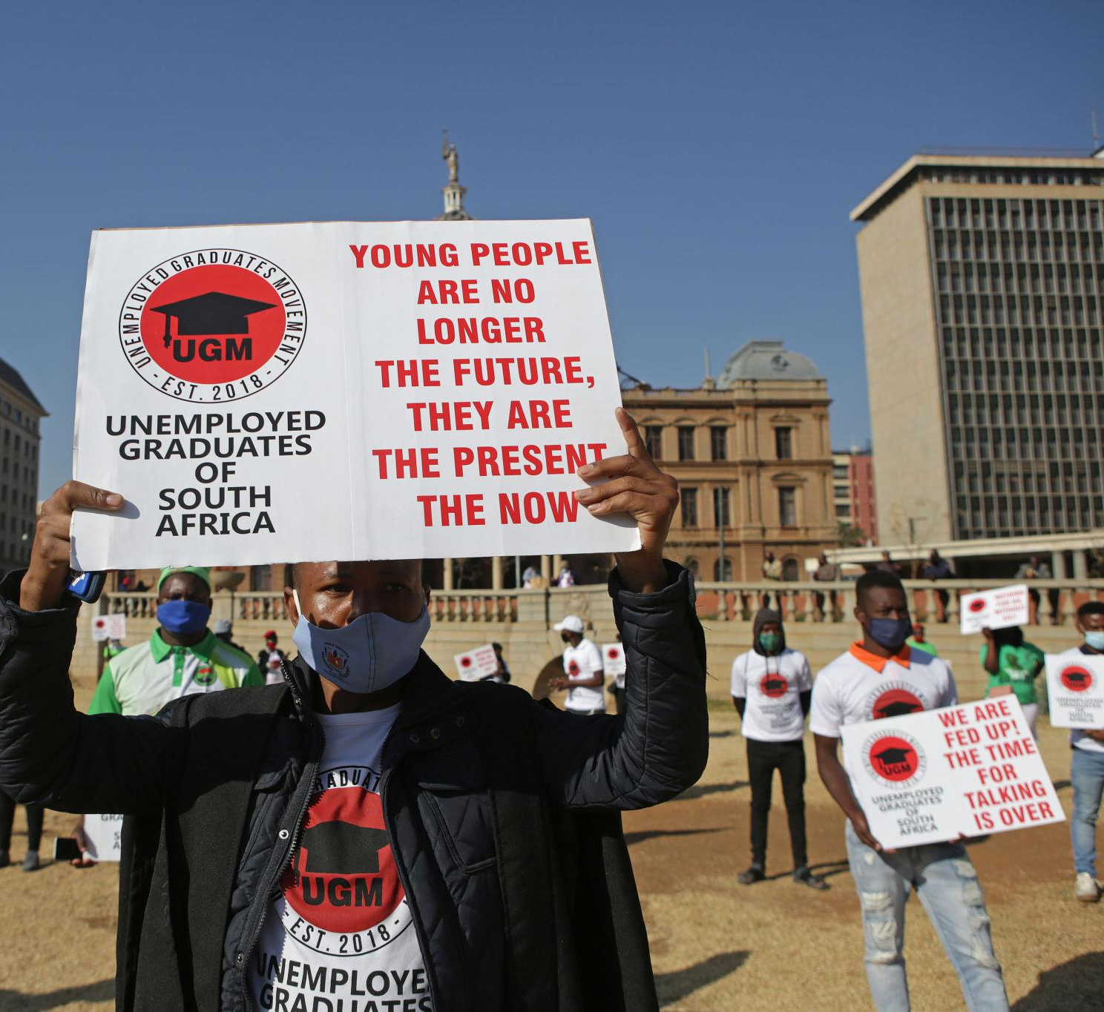
Why does the NYDA Need a Dedicated Economic Research Agenda?
Youth unemployment remains structurally entrenched
The NEET population continues to expand
Youth are disproportionately represented in informal and precarious work
Current policy responses are fragmented across departments
Youth fiscal allocations are not systematically tracked
Economic shocks (inflation, climate, fiscal consolidation, etc) affect youth first
NYDA must move from programme administration to evidence leadership

Slide 3


What Guides the NYDA Economic Research Agenda?
National policy frameworks
National Youth Policy (NYP 2030)
National Development Plan (NDP 2030)
Medium-Term Development Plan (MTDP)
Growth Acceleration and Inclusion (GAIN)
Institutional frameworks
NYDA Act
NYDA Board Strategy
Integrated Youth Development Strategy (IYDS)
Management Strategy 2026 - Pax Africana Moment
Alignment with national priorities and government policy direction
Research anchored in long-term development goals and institutional mandates
Provides a strategic framework for programme focus and investment priorities

Slide 4
Strategic Objectives of the Economic Research Agenda
The research agenda is divided into five core economic research pillars with a strategic objective to:
  Provide evidence-based insights on youth economic conditions to support strategic decision-making within the NYDA.
  Inform the design, targeting and improvement of NYDA programmes to ensure they respond to real economic challenges facing young people.
  Support the monitoring and evaluation of programme outcomes, enabling the Agency to measure meaningful impact and improve effectiveness over time.
  Guide the mobilisation and allocation of financial resources by identifying priority sectors, financing gaps and high-impact interventions.
  Strengthen the economic rationale for investment partnerships with government, the private sector and international development partners.
  Enable the NYDA to communicate credible policy insights and evidence to stakeholders, including policymakers, investors and development partners.
  Position the NYDA as a national knowledge hub on youth economic development, supporting policy dialogue and advocacy.

Slide 5


Deep-dive into the five core pillars of the research
agenda

Slide 6



Core Economic Research Pillars
PILLAR 1: Youth Labour Markets and Structural Transformation
South Africa’s youth unemployment crisis reflects structural constraints, not individual failure. The issue is demand-side, sectoral and spatial.
Research Focus Areas
Dynamics of youth unemployment (long-term, discouraged workers)
NEET analysis (Not in Employment, Education or Training)
Youth participation in the informal economy
Sectoral job absorption capacity (manufacturing, green economy, digital, etc)
Spatial exclusion (townships, rural youth, former homelands)
Understanding youth labour market transitions
Removing systemic barriers for marginalised youth, particularly LGBTI+ and persons with disabilities
Research will identify sectors with the greatest potential for youth employment. This evidence will guide investment partnerships in labour-intensive sectors, industrial development initiatives and public employment programmes

Slide 7
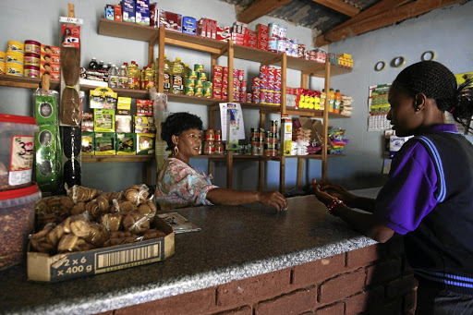

Core Economic Research Pillars
PILLAR 2: Youth Enterprise, Finance and Asset Formation
Youth entrepreneurship in South Africa is often survivalist. The question is not whether youth are entrepreneurial, but whether they are well capitalised.
Research Focus Areas
Survivalist vs growth-oriented enterprises
Access to credit and blended finance models
Youth participation in value chains
Cooperative and collective enterprise models
Youth participation in public procurement
Land access and agrarian youth participation
This pillar directly supports investment in entrepreneurship development programmes. Research will analyse barriers facing youth-owned enterprises and inform the design of youth enterprise funds, financing partnerships and entrepreneurship programmes.

Slide 8



Core Economic Research Pillars
PILLAR 3: Cost of Living, Inequality and Social Protection
Inflation is not neutral. Food, transport, rent and data costs affect youth differently.
Research Focus Areas
Youth-specific inflation patterns
Transport burden for work seekers
Housing precarity among youth
Student debt and household support burdens
Distributional effects of VAT and indirect taxes
SRD and youth income support outcomes
Urban–rural consumption disparities
This research can guide partnerships supporting youth transport subsidies, housing-linked employment programmes and social protection interventions.

Slide 9



Core Economic Research Pillars
PILLAR 4: Public Finance and Youth Budgeting
Youth development is under-budgeted and fragmented across departments.
Research Focus Areas
Youth expenditure mapping across the consolidated budget
Evaluating fiscal consolidation impacts on youth
Conditional grants and youth outcomes
Cost–benefit analysis of youth programmes
Gender and youth-responsive budgeting
Alignment with Medium-Term Development Plan
Measuring fiscal multipliers of youth investment
This evidence will strengthen NYDA’s engagement with National Treasury, provincial governments and development finance institutions.

Slide 10
Core Economic Research Pillars
PILLAR 5: Digital Economy and Future of Work
AI, automation and platform work are reshaping entry-level jobs.
Research Focus Areas
Platform labour and precariousness
Digital divide in township and rural areas
Skills mismatch and SETA effectiveness
Artificial intelligence and job displacement risks
Green economy employment pathways
Youth in creative and digital sectors
Digital entrepreneurship ecosystems
Research will guide investment in digital skills and emerging sectors.

